Slide 1
Enterprise SRE & IT Operations Intelligence Platform
Presented by: US SRE Team
Core Team Engineers: Rauf, Anurag, and Kaynat
Operations Deployment Node: 100% On-Premises Local Environment

Slide 2
Agenda
System Architecture & Workflow Overview — Air-gapped design, offline-first LLM setup, and end-to-end data flow.
Project Demo (Part 1) — Data ingestion pipelines, dynamic date filtering, and real-time operations HUD.
Operational Logic — Multi-variable metric scaling, vector normalization, and dynamic weight matrix.
Project Demo (Part 2) — Semantic vector search (RAG), local LLM diagnostic audits, and AI agent coaching.
Systemic Root Cause Analytics — Infrastructure noise clustering, security playbooks, and executive exports.

Slide 3
Architecture and Overview of the project

Slide 4
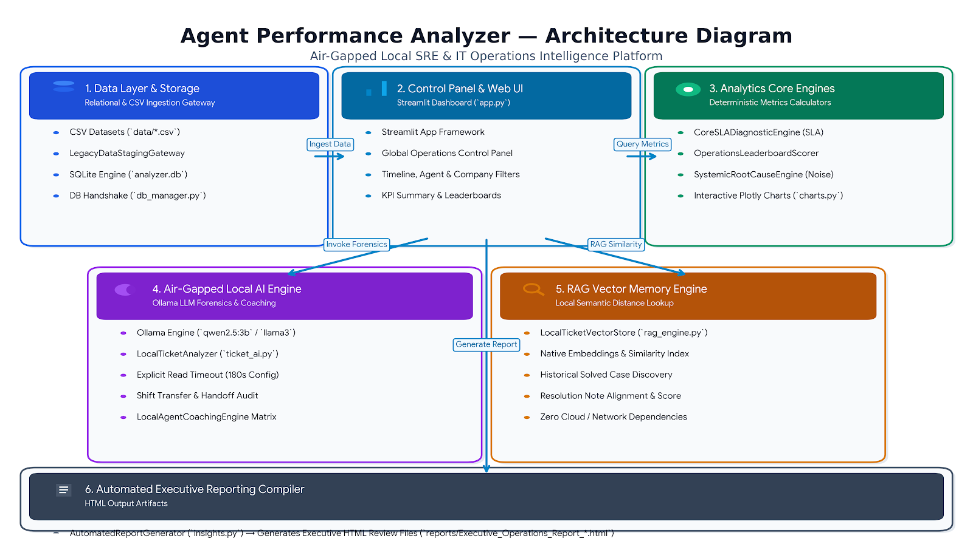

Slide 5
System Architecture & Technical Stack
FRONTEND & UI ENGINE
Streamlit
Reactive UI with dual-theme glassmorphism, responsive metric cards, and CSS menu overrides.
DATA & STORAGE LAYER
Pandas + SQLite3
Localized fast-read SQLite staging gateway (analyzer.db) with pre-compiled B-tree indexes.
DOCUMENT EXPORT ENGINE
xhtml2pdf + HTML5
Enterprise SLA report generator compiling HTML templates into paginated executive PDFs.
AIR-GAPPED AI INFERENCE
Ollama (qwen2.5:3b)
Self-hosted local LLM endpoint running at localhost:11434 with strict JSON schema parsing.

Slide 6
📂 Directory Structure
.
├── analytics/ # Core AI, SLAs, Forensics, Root-Cause & Scoring logic
│ ├── noise_cluster.py
│ ├── scoring.py
│ └── ticket_explorer.py
├── utils/ # ETL loaders, database managers, and HTML compilers
│ ├── db_manager.py
│ ├── insights.py
│ └── loader.py
├── data/ # Drop zone for target .csv dataset ingestion
├── reports/ # Output destination for generated HTML/PDF Executive Reviews
├── app.py # Main Streamlit dashboard application UI
├── config.py # Centralized environment constants & model weights configuration
├── newsetup_master.sh # One-click deployment environment bootstrapping script
├── IMPLEMENTATION.md # Detailed Architecture and Engineering documentation
└── README.md # Project documentation

Slide 7
Executive Presentation Agenda
01. Executive Summary & Problem Statement
Understanding the need for air-gapped SRE analytics.
02. End-to-End Data Pipeline (Input / Output)
Ingestion from raw CSVs to SQLite staging and reporting.
03. SLA Compliance & Diagnostic Engine
Auditing resolution times against P0-P3 severity limits.
04. Performance Score Math & Dynamic Weights
Detailed mathematical formulation of SRE matrix scoring.
05. Backend Mathematical & SLA Implementation
Code-level equations for SLA compliance & vector scoring.
06. Infrastructure Noise Clustering & Playbooks
Top 5 systemic alerts and local LLM security playbooks.
07. Forensic Ticket Investigator & AI Coaching
Semantic vector search and localized agent coaching.
08. Automated Executive Reporting Engine
Dynamic HTML/PDF executive review generation.
09. System Architecture & Scalability Roadmap
Tech stack, Streamlit UI, and PostgreSQL/Vector DB roadmap.

Slide 8
End-to-End Data Pipeline: Inputs & Outputs
📥 INPUT DATA SPECIFICATION
Raw Ticket Exports (data/*.csv):
• Ticket ID & Timestamps (Created Time, Resolved Time)
• Ticket Metadata (Subject, Description, Priority, Status)
• Operational Context (Company, Ticket Type / Category)
• Human Effort Metrics (Effort Required in Mins, Resolution Hours)
• Agent Identity & Resolution Notes
Data Ingestion Resilience (utils/loader.py):
• Dynamic header parsing & numerical coercion
• Automated timestamp difference fallback if Resolution Hours missing
• Purges staging cache & performs batch upserts into SQLite DB
📤 OUTPUT ARTIFACTS & DELIVERABLES
Interactive Operations Dashboard (Streamlit UI):
• Real-time reactive Leaderboard & SRE performance ranking
• Dual SLA Tracking Tables (Compliant vs Breached tickets)
• Interactive Plotly distribution & workload charts
AI Forensic & Security Playbooks:
• Top 5 Infrastructure Noise Alerts & security playbooks
• LLM Ticket Forensic Diagnostics (Root Cause & Summaries)
• Personalized Local AI Career Coaching Profiles
Executive Exports (reports/):
• Standalone Executive HTML & PDF Operations Review Reports

Slide 9
SLA Compliance Engine & Audit Rules
URGENT (P0)
4.0 Hours
Critical infrastructure outages, high security risks.
HIGH (P1)
8.0 Hours
Core service degradation affecting enterprise workflows.
MEDIUM (P2)
16.0 Hours
Standard operational requests and minor service issues.
LOW (P3)
24.0 Hours
Informational queries, access requests, general routine tasks.
🔍 SLA AUDIT & DIAGNOSTIC LOGIC (analytics/sla.py)
• Timestamp Precision: Compares ticket resolution duration (resolution_hours) strictly against SLA_TARGETS[priority].
• Compliance Binary Mapping: Tags every ticket with sla_breached = 0 (Compliant) or sla_breached = 1 (Breached).
• Global System Audit: Automatically flags missing priority tags, assigning default medium priority rules where unassigned.
• Real-time Metric Aggregation: Computes team-wide compliance percentage: Compliance Rate = (Compliant Tickets / Total Tickets) * 100.

Slide 10
Performance Score Formula & Weight Matrix
CORE SRE PERFORMANCE SCORE MATHEMATICAL FORMULA
Score = [ (SLA_Score × w_sla) + (Speed_Score × w_speed) + (Vol_Score × w_vol) + (Effort_Score × w_effort) ] × 100
INCIDENT MODE
Prioritizes Speed & SLA Limits
• SLA Compliance (w_sla): 50%
• Resolution Speed (w_speed): 35%
• Volume Impact (w_vol): 10%
• Effort Efficiency (w_effort): 5%
SERVICE REQUEST (SR)
Prioritizes Volume Throughput
• Volume Impact (w_vol): 40%
• SLA Compliance (w_sla): 20%
• Resolution Speed (w_speed): 20%
• Effort Efficiency (w_effort): 20%
ALL TYPES (BALANCED)
Standard Baseline Matrix
• SLA Compliance (w_sla): 40%
• Resolution Speed (w_speed): 30%
• Volume Impact (w_vol): 20%
• Effort Efficiency (w_effort): 10%

Slide 11
Infrastructure Noise Clustering & AI Playbooks
🚨 TOP 5 SYSTEMIC ALERTS (analytics/noise_cluster.py)
Systemic Pattern Frequency Mining:
• Aggregates high-frequency repetitive ticket subjects across target companies.
• Surfaces Top 5 highest frequency operational alerts.
Operational Value:
• Prevents team burnout by isolating recurring infrastructure bugs.
• Distinguishes true operational incidents from background noise.
• Provides executive visibility into enterprise company risk profiles.

Slide 12
Project - Demo

Slide 13
What We Have Accomplished
Key Engineering Milestones Delivered
End-to-End Local Data Pipeline: Engineered an air-gapped ETL pipeline that converts raw CSV logs into an indexed SQLite storage layer with sub-second query retrieval and automated system noise filtering.
Mathematical Operations Audit: Implemented strict SLA breach diagnostic engines and a 4-variable weighted performance scoring algorithm to track team efficiency.
Air-Gapped AI & Forensics Orchestration: Deployed offline LLM incident analysis, shift-handoff mistake detection, and pattern clustering using qwen2.5:3b weights via a local Ollama daemon with custom timeout controls.
Executive Delivery Suite: Packaged the system with a multi-filter Streamlit dashboard, RAG-driven vector similarity matching, and an automated standalone HTML executive report compiler.

